Slide 1
7.0 Laplace Transform
EE1203 – Theory of Electricity
Prof J. Rohan Lucas
lucas@kdu.ac.lk
Department of Electrical, Electronic & Telecommunication Engineering
General Sir John Kotelawala Defence University
September 2020

Slide 2
Learning Outcomes
On completion of module, student will be able to
LO1: Analyse the performances of AC circuits
Analyse circuits using nodal and mesh theory
LO2: Analyse two port networks using different models.
LO3: Analyse transfer functions of RLC networks for transients.
LO4: Analyse waveforms for its harmonics.
LO5: Perform calculations in three phase circuits including unbalanced waveforms.
t
Notes:
.

Slide 3
Repetitiveness of Non-Sinusoidal Waveforms
f(t)
T
t
(a)
f(t)
T
t
(b)
f(t)
(c)
t
Figure 1 – Period of repetition gradually increased to ∞

Slide 4
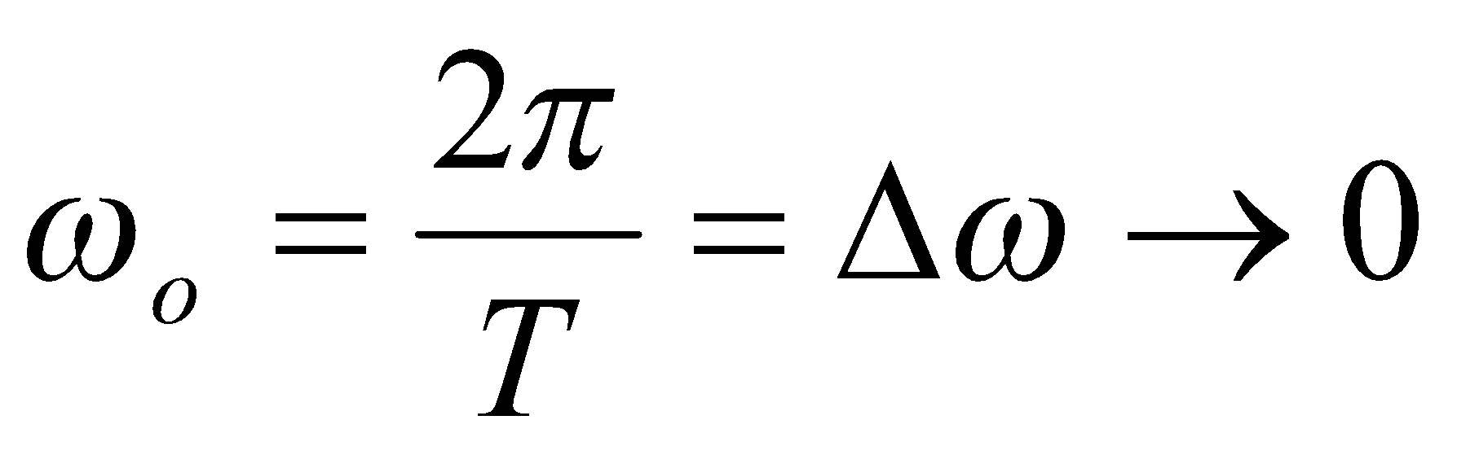
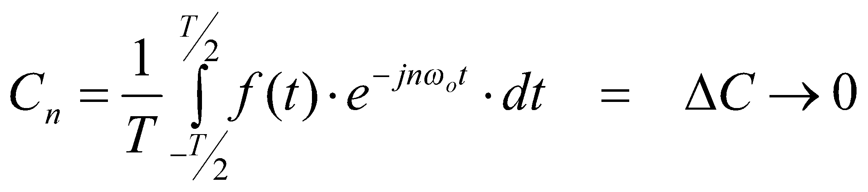
Any non-repetitive waveform may be thus considered with a period T→ ∞, and corresponding fundamental frequency
Fourier coefficients C_{n} in symmetrical exponential series
Frequencies involved are no longer discrete but continuous.
General frequency nω_{o} corresponds to ΣΔω
or as Δω→0, ∫dω = ω

Slide 5
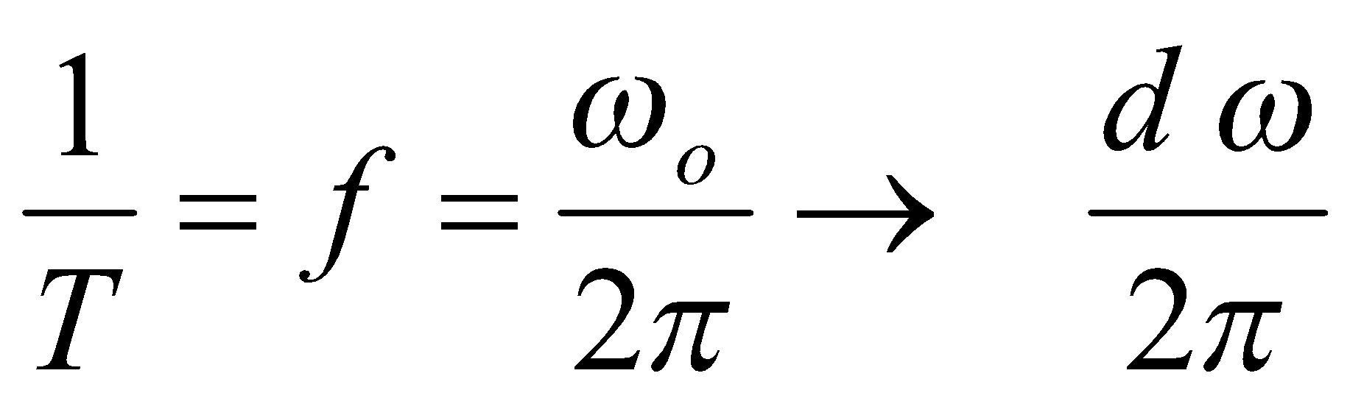
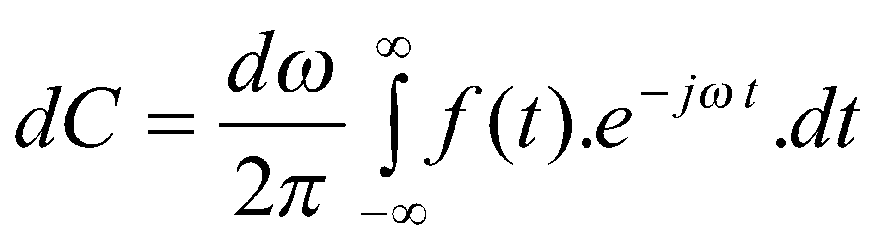
For non-repetitive functions, following can be written.
T → ∞
ω_{o} → dω
C_{n} → dC
nω_{o} → ω
f(t)
t
Expression for complex Fourier Coefficient C_{n} becomes

Slide 6
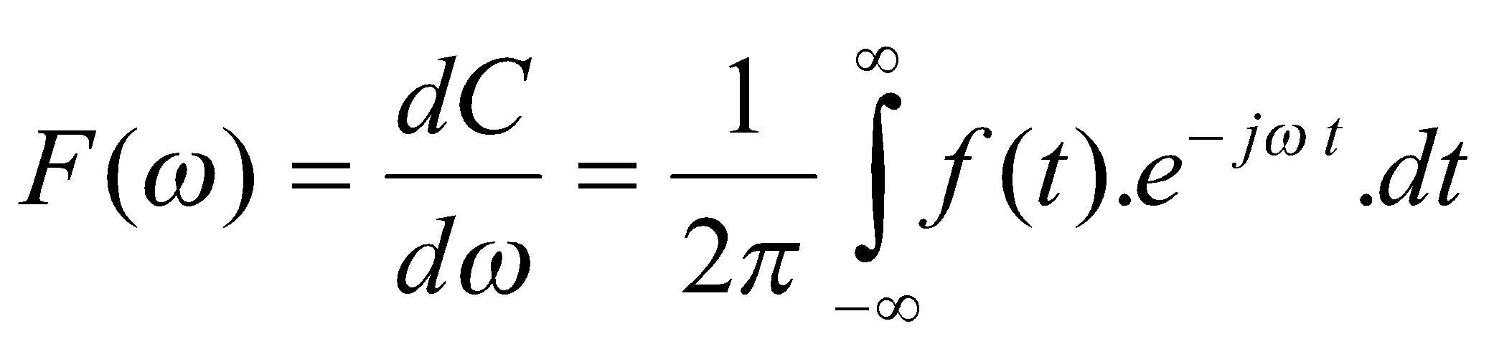
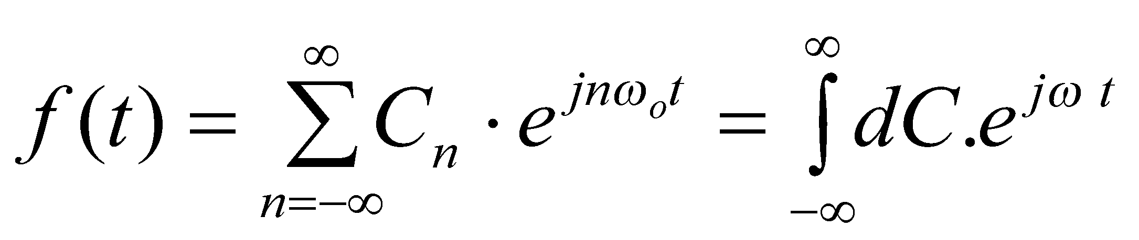
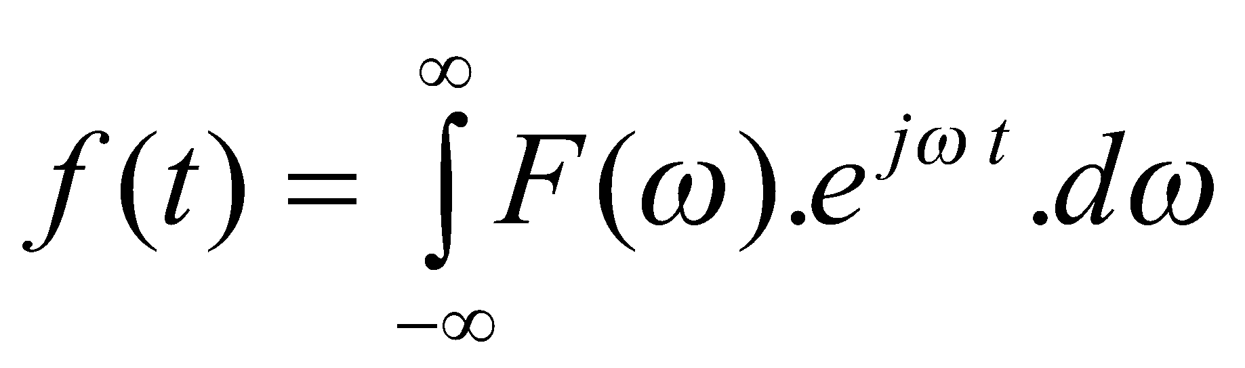
Dividing both sides by dω,
Fourier Transform
The original function f(t) is now given as
from the definition, dC = F(ω).dω, so that
Fourier Inverse Transform
Fourier Transform expression and Fourier Inverse Transform expression together are known as Fourier Transform Pair.
Fourier Inverse Transform

Slide 7
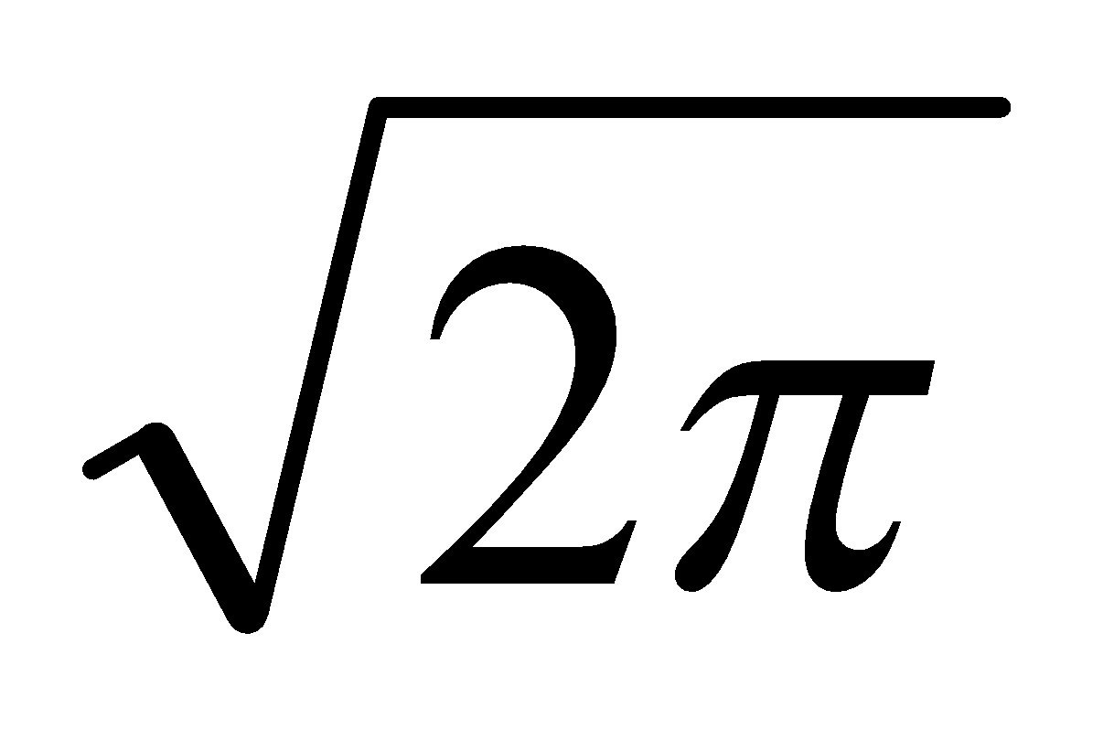
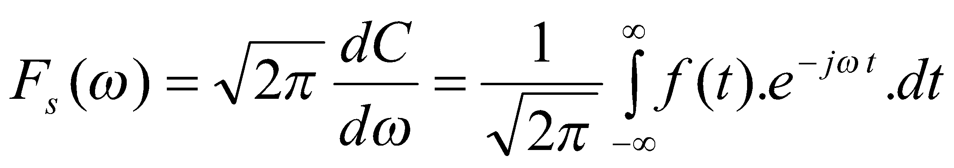
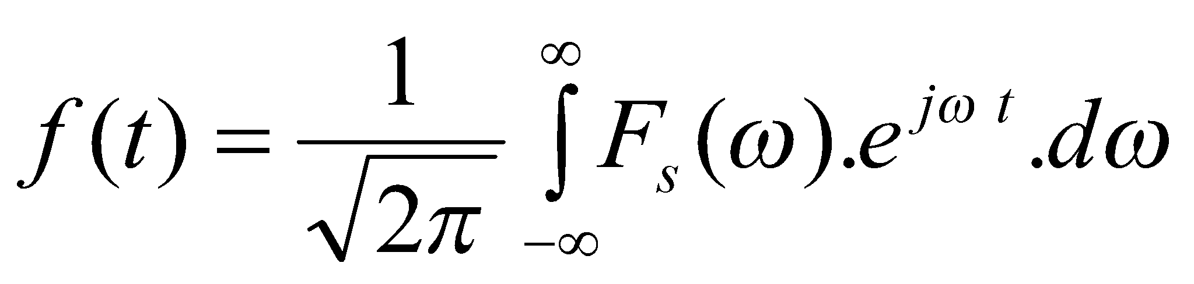
Symmetric Fourier Transform
If Fourier Transform is multiplied by a constant and Inverse Transform divided by same constant, we get modified transform pair.
Could define Symmetrical Transform pair by using a factor
and corresponding Symmetric Inverse Transform
Fourier Transform is useful in analysing transients in electrical circuits, especially where the elements are frequency dependant.

Slide 8
For functions which do not decay till infinite time (including waveforms such as causal sinusoids), Fourier Transform cannot be obtained.
To avoid this problem, waveforms which do not decay may be artificially decayed by an exponential factor to allow integration.
Integrated result is then exponentially magnified to correct for the initial decay introduced.
However, such exponential magnification can also magnify numerical errors.
a(t)
t
a(t)
t
t
a(t)
t
t
Laplace Transform is defined based on this artificial decay.

Slide 9
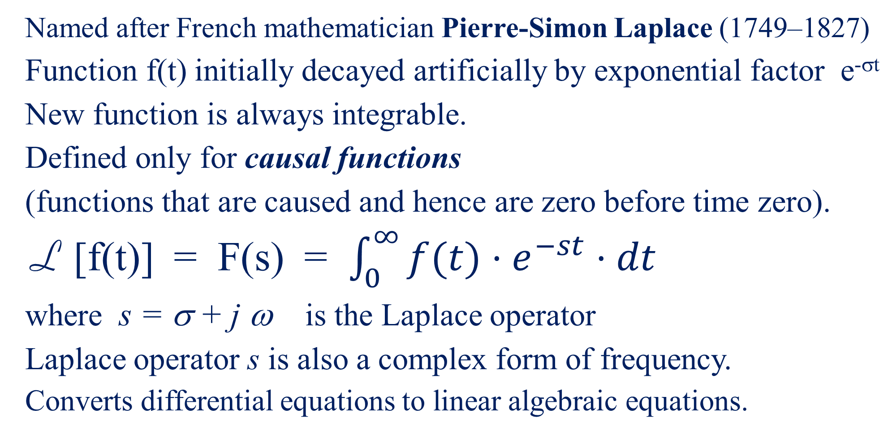
Laplace Transform
Notes:
Laplace transform, in mathematics, a particular integral transform invented by the French mathematician Pierre-Simon Laplace (1749–1827), and systematically developed by the British physicist Oliver Heaviside (1850–1925), to simplify the solution of many differential equations that describe physical processes.

Slide 10
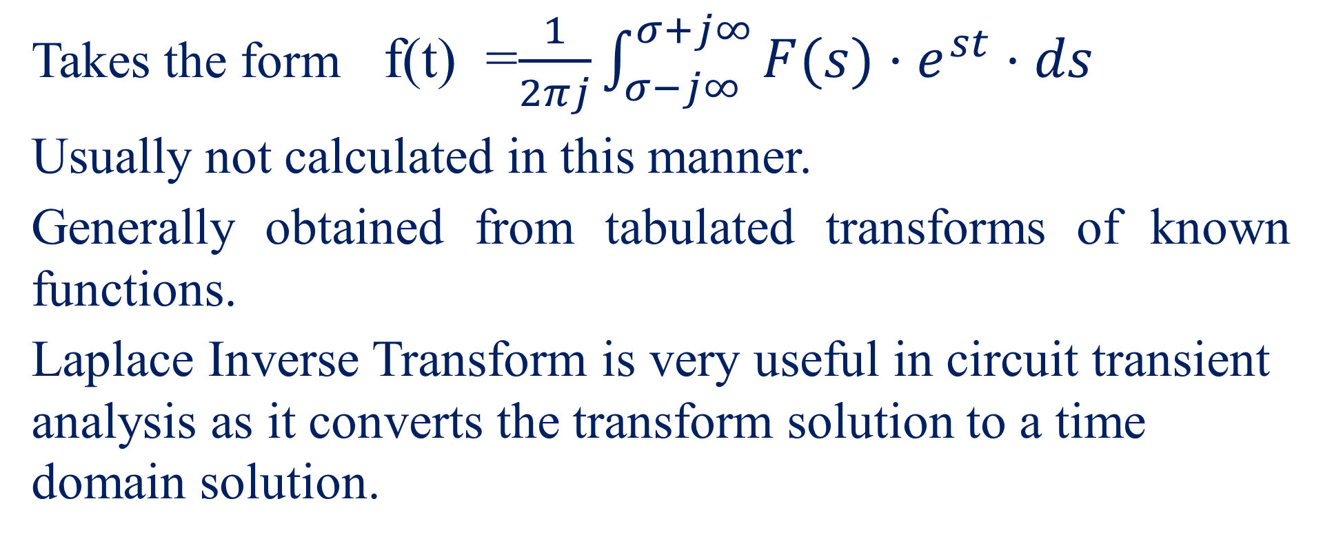
Laplace Inverse Transform

Slide 11
Response of a linear Passive Bilateral Network
e(t)
r(t)
Linear Passive bilateral Network
Figure 2 – Transfer Function
Response r(t) related to input e(t) by an ordinary linear differential equation.
r(t) = F(p) . e(t)
where p = d/dt = differential operator
Consider an exponential excitation function e^{st}.
i.e. e(t) = e^{st} → r(t) = F(p) . e^{st} = e^{st} . F(s)

Slide 12
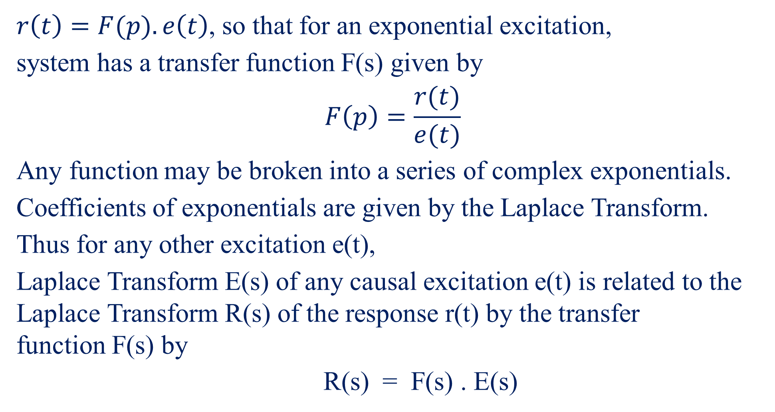

Slide 13
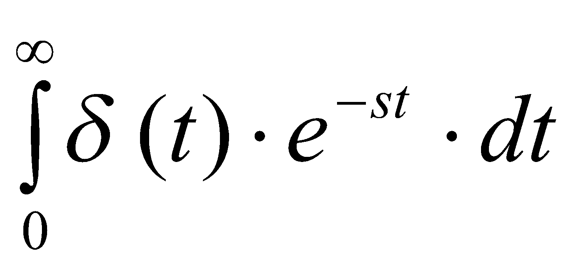
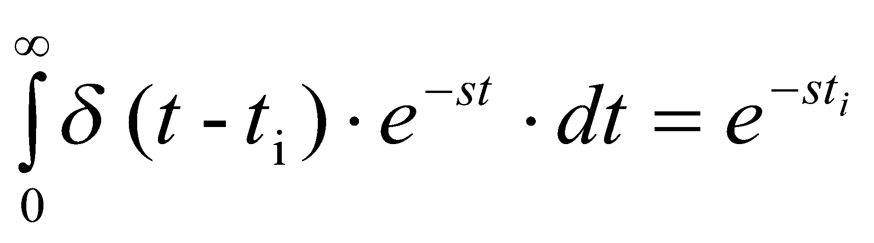
Laplace Transform of Special Causal Functions
(a) Unit impulse function δ(t)
Unit impulse has a value 0 at all values of t other than at t = 0 where it has an infinite magnitude.
Integral of unit impulse function over time is equal to 1.
L [δ(t)] =
δ(t)
∞
= 1
If unit impulse occurs at t = t_{i}, rather than at t = 0, function is δ (t − t_{i}).
t
δ(t-t_{i})
∞
L [δ(t − t_{i})] =
t
t_{i}

Slide 14
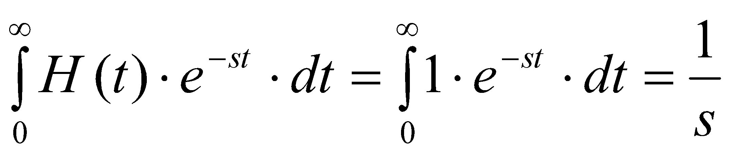
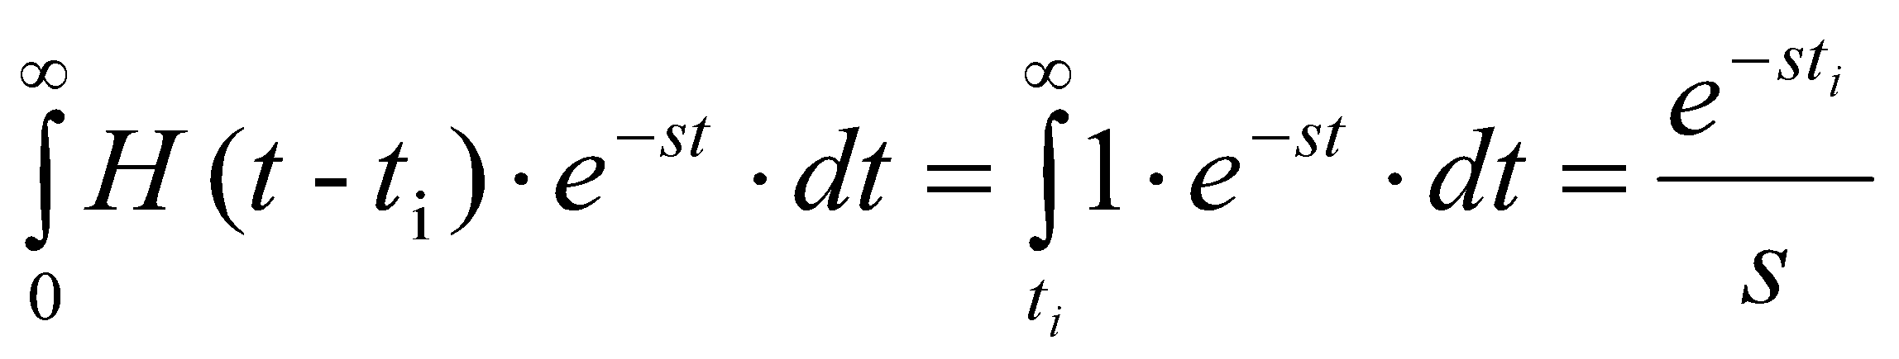
(b) Unit step function H(t)
H(t)
Unit step has value 0 for values of t < 0
and a value of 1 for t > 0.
1
t
L [H(t)] =
H(t-t_{i})
If unit step occurs at t = t_{i}, and not at t = 0,
then the function is H(t − t_{i}).
1
t
t_{i}
L[H(t − t_{i})]=

Slide 15
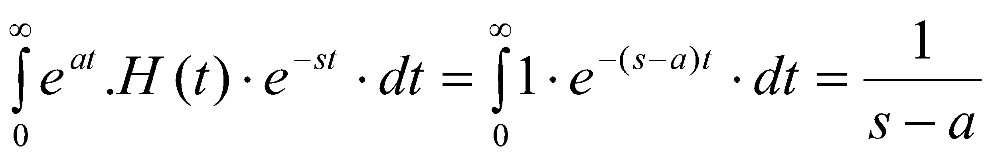
(c) Causal exponential function e^{at} . H(t)
e^{at}.H(t)
1
t
L [e^{at}.H(t)] =

Slide 16
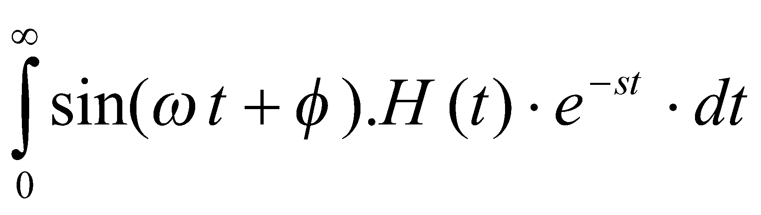
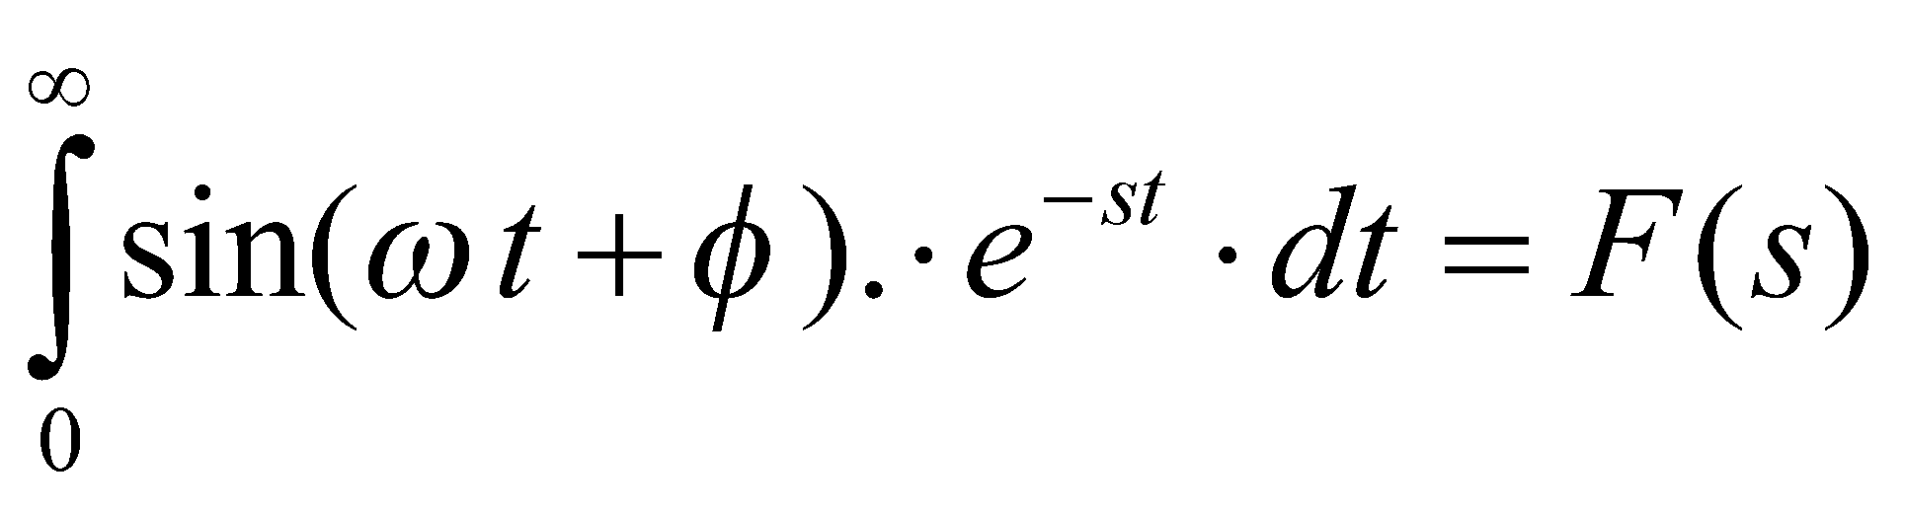
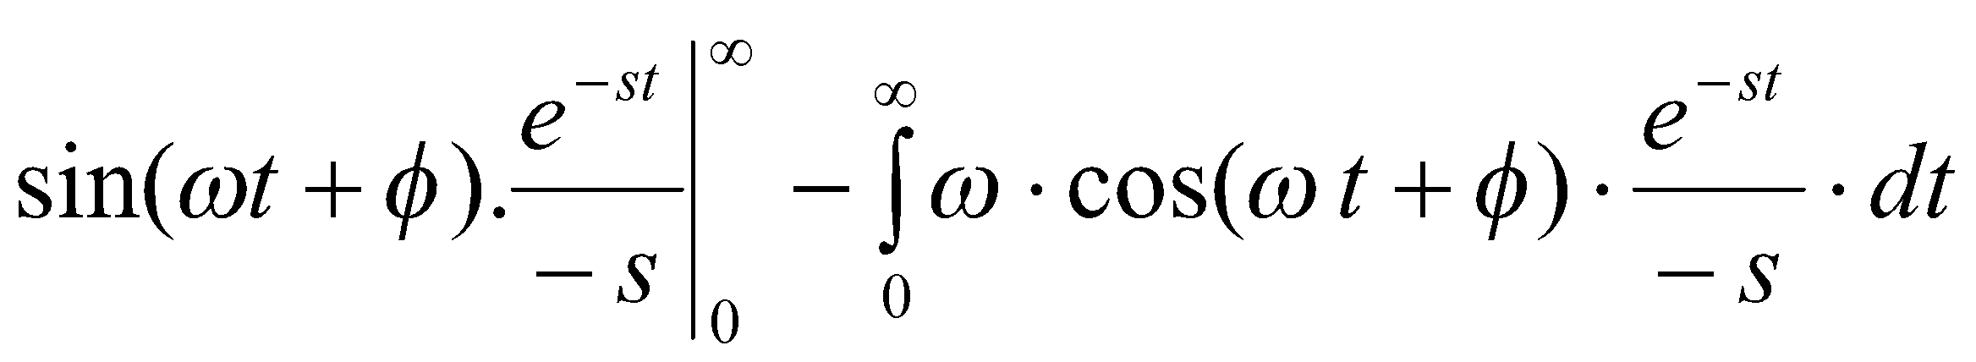
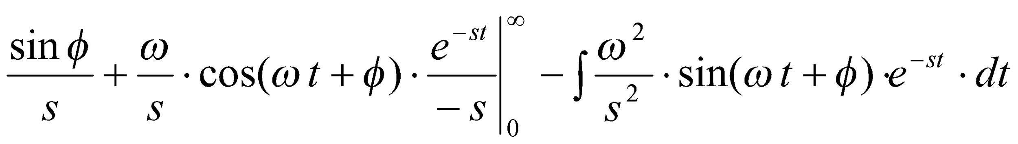
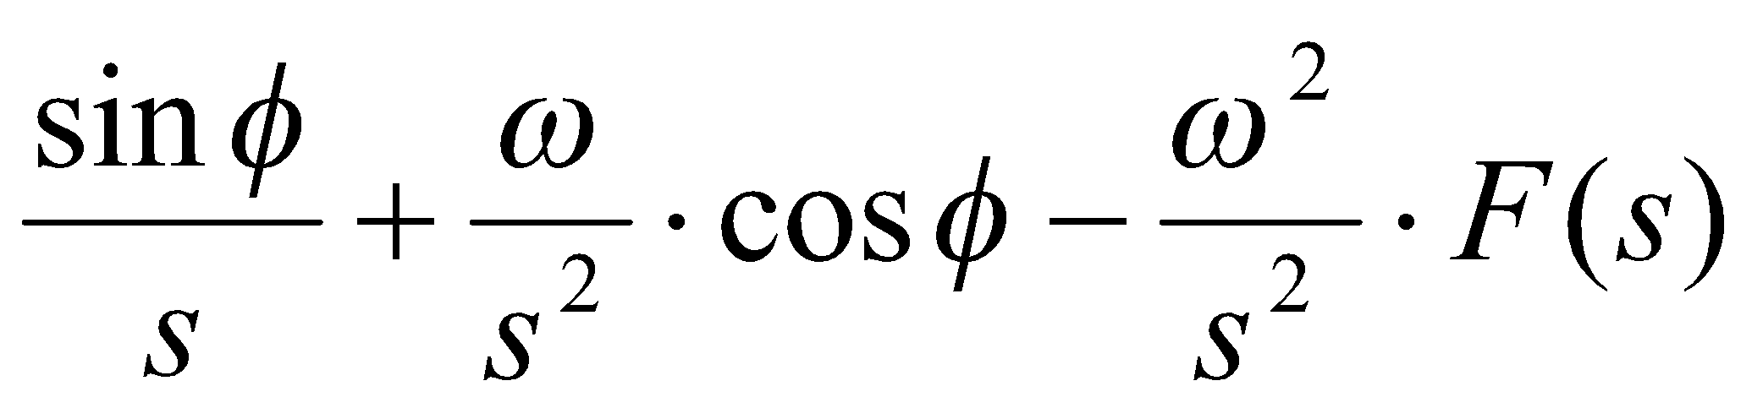
(d) Causal Sinusoidal function sin(w t+f) .H(t)
L [sin(wt+f).H(t)] =
=
t
F(s) =
=
=

Slide 17
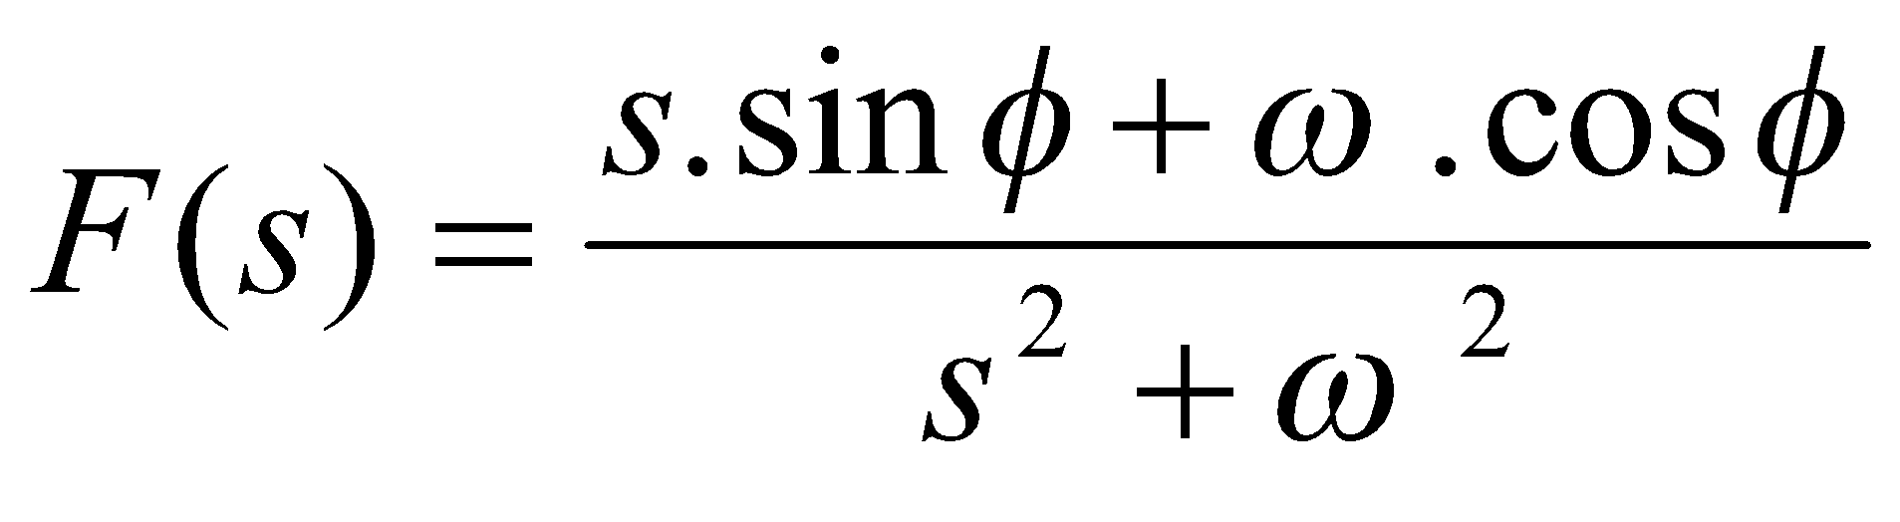
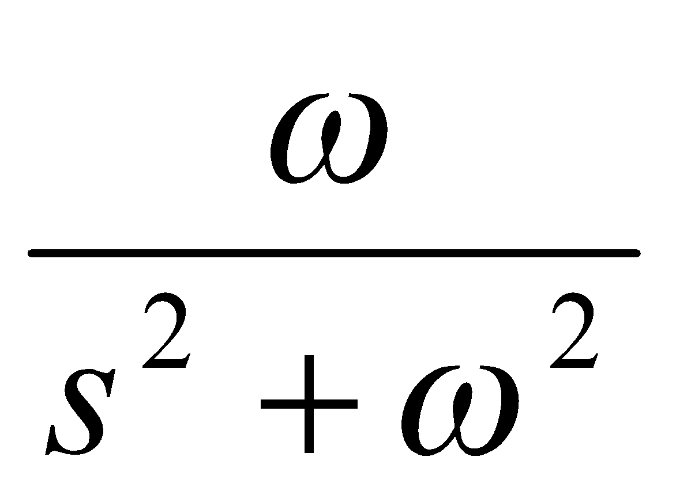
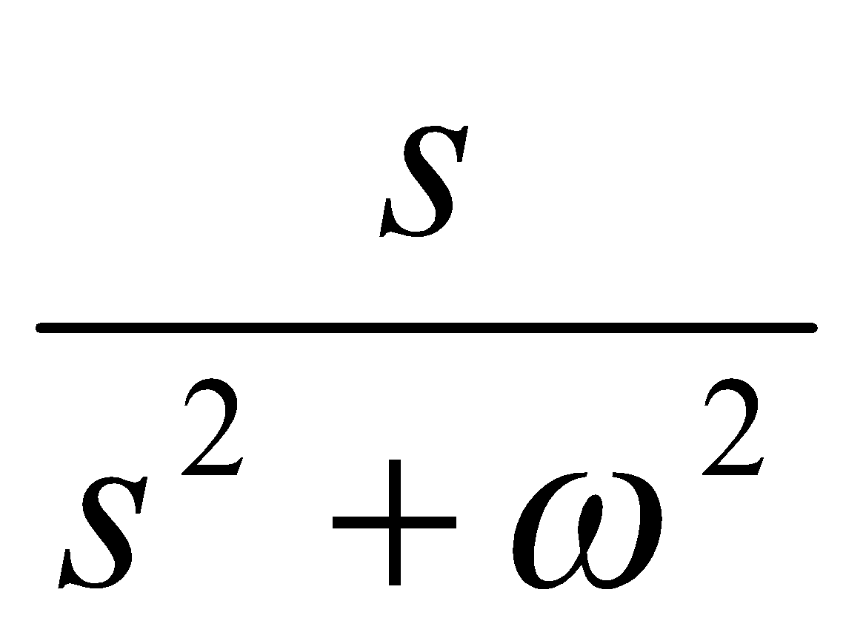
(s2+ω²). F(s) = s . sin φ + ω . cos φ
t
with φ = 0º the following is obtained.
L [sin ωt.H(t)] =
t
And with φ = 90º the following is obtained.
, L [cos ωt.H(t)] =
t

Slide 18
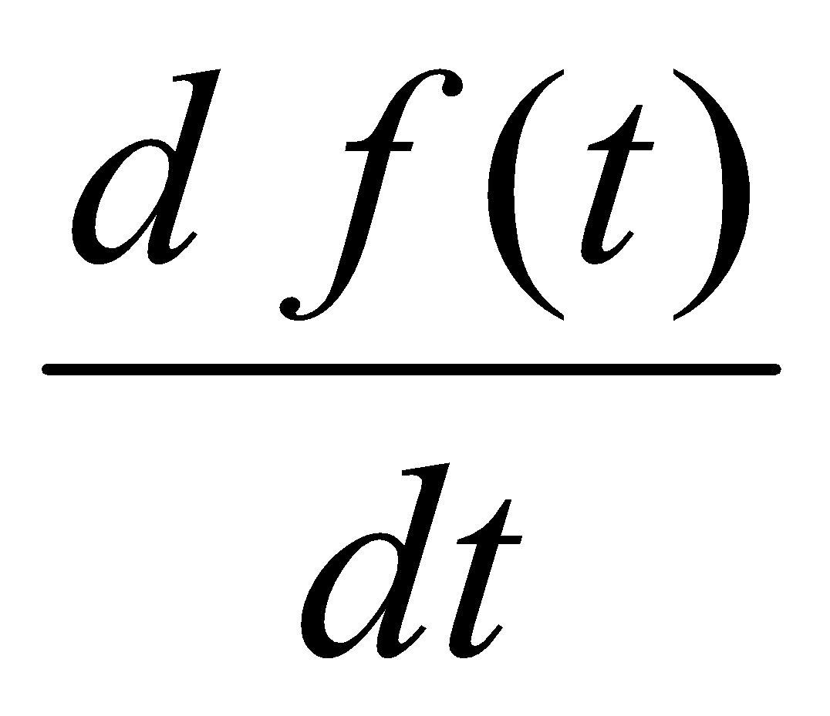
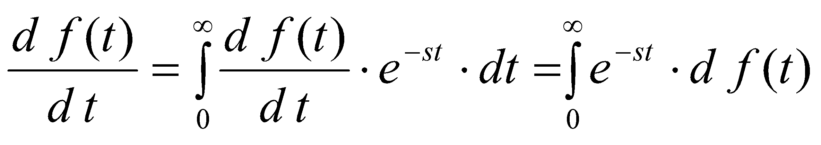
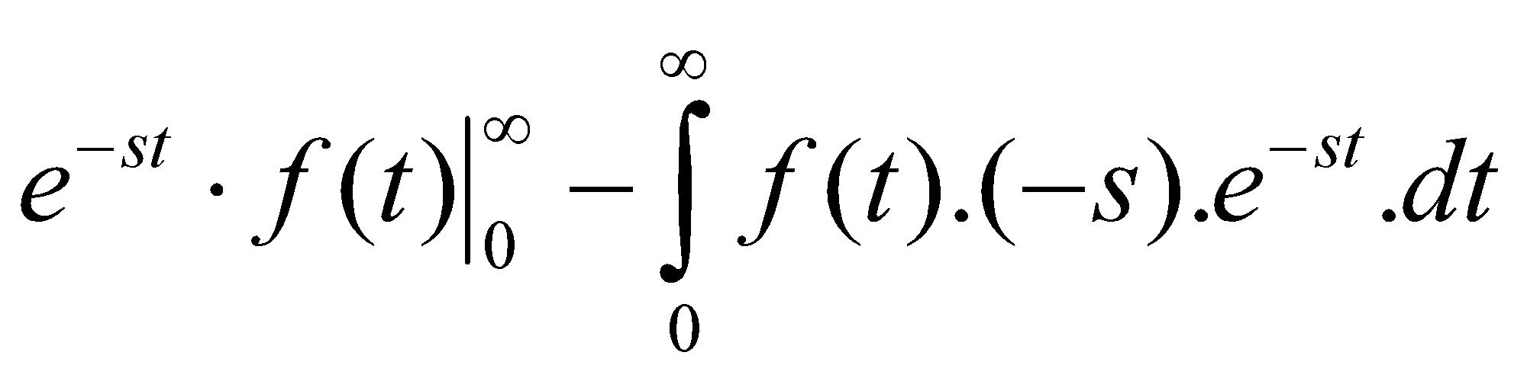
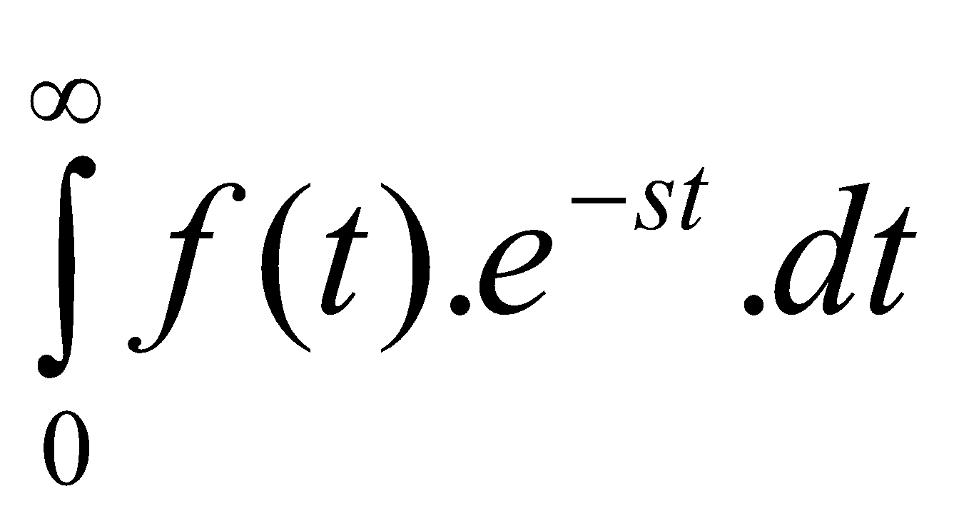
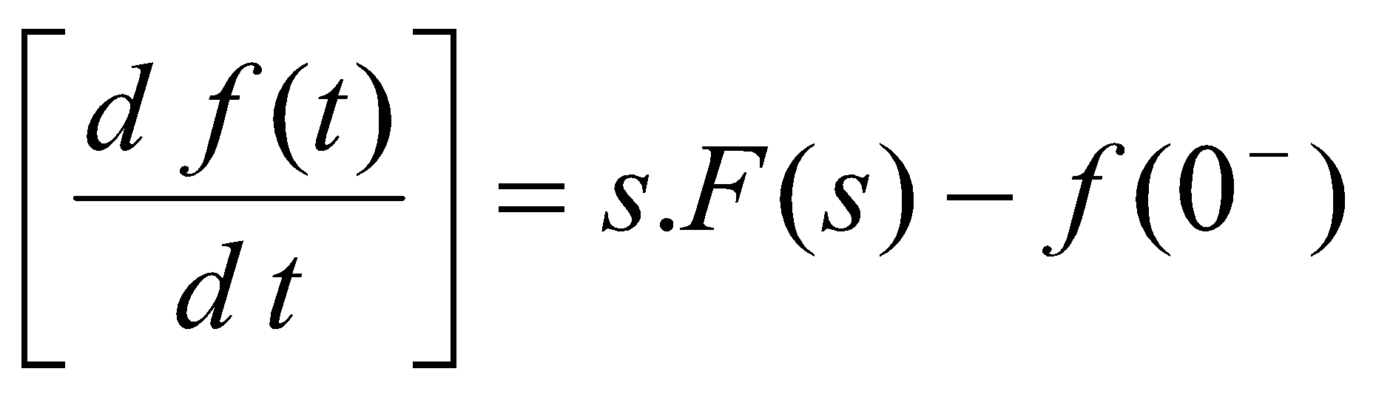
(e) Laplace Transform of the causal derivative
L
=
= (-) f(0⁻) + s.
L
Note: Unlike in case of ordinary derivative, transform of derivative also keeps information about initial condition [i.e. f(0⁻)]

Slide 19
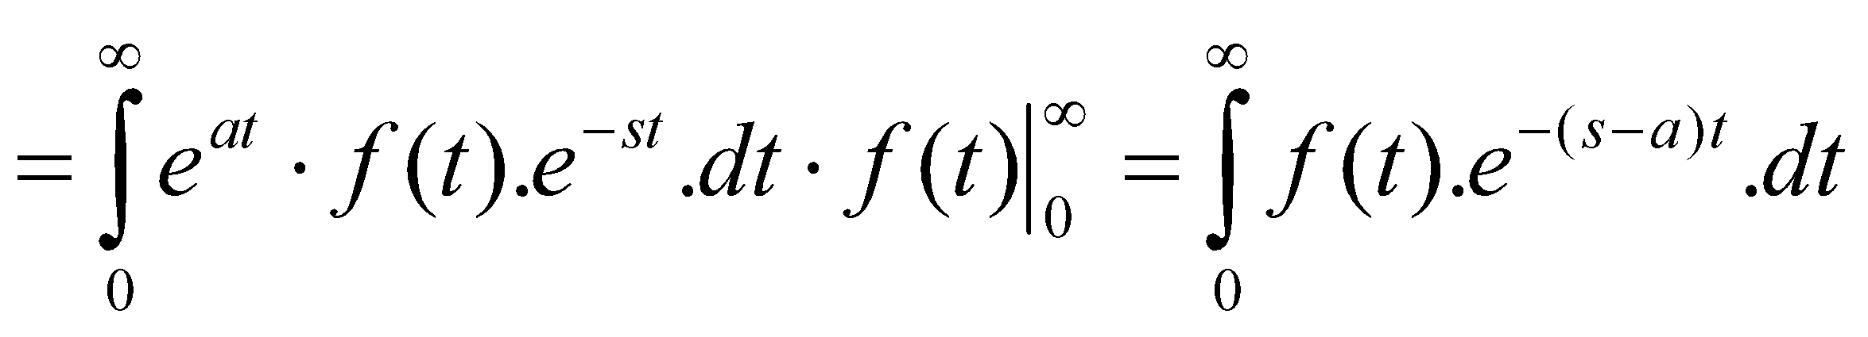
(f) Exponential multiplication of e^{at} in the time domain
An exponential multiplication of e^{at} in the time domain corresponds to a shift of a in the s-domain.
L [e^{at} . f(t)]
= F(s-a)

Slide 20
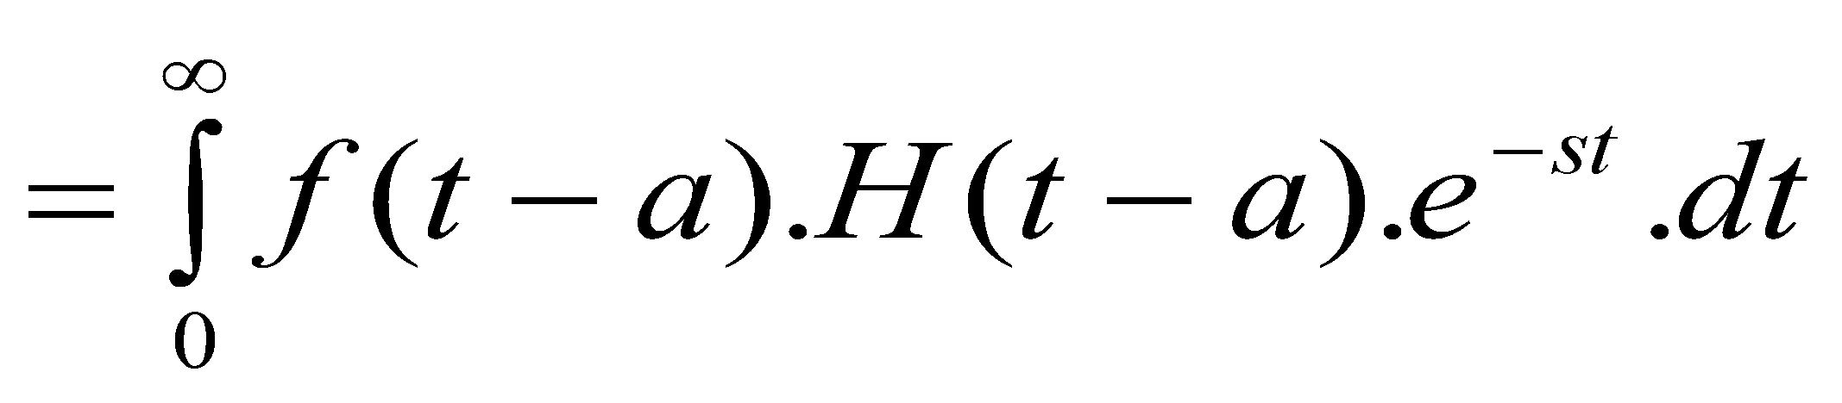
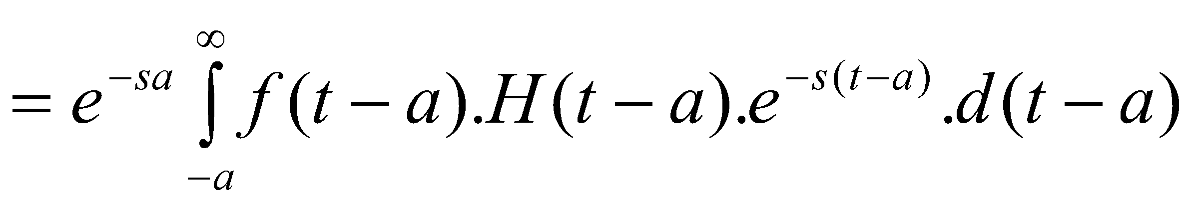
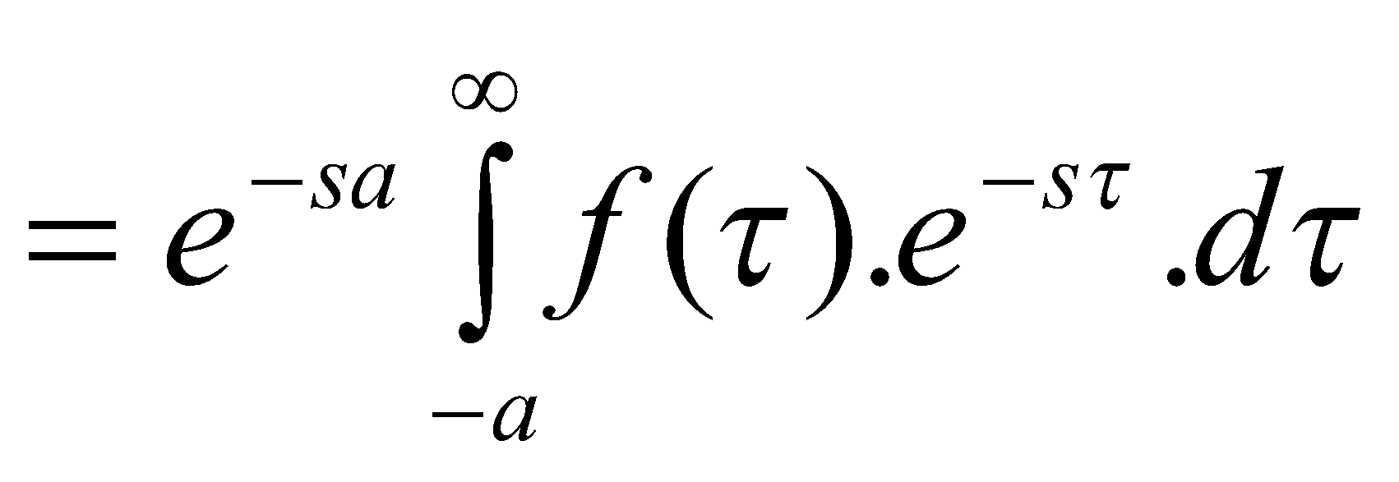
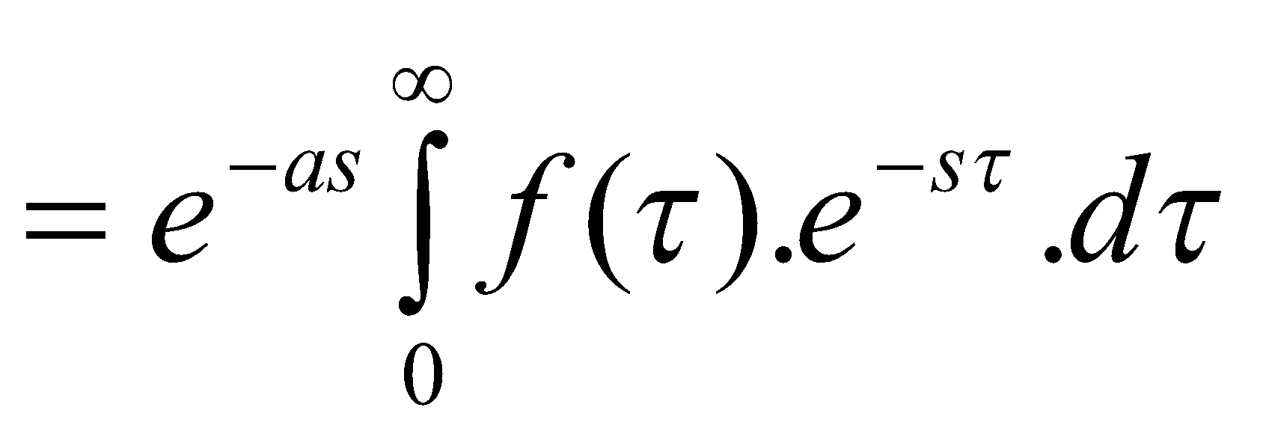
(g) A shift in the time domain
A shift of a in time domain f(t – a).H(t – a), corresponds to an exponential decay in the s-domain.
L [f(t-a).H(t-a)]
= e^{-as}. F(s) since f(τ) = 0 for τ < 0.

Slide 21
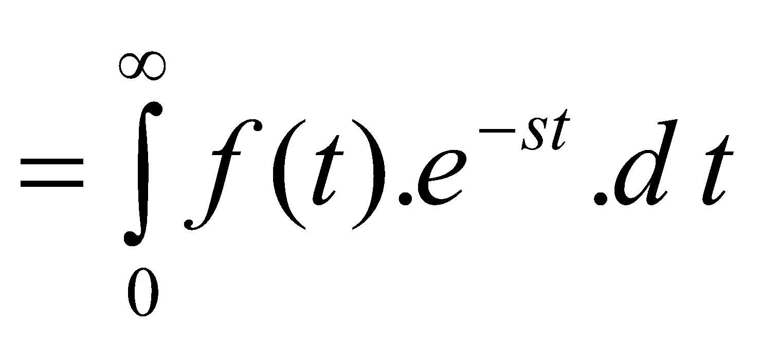
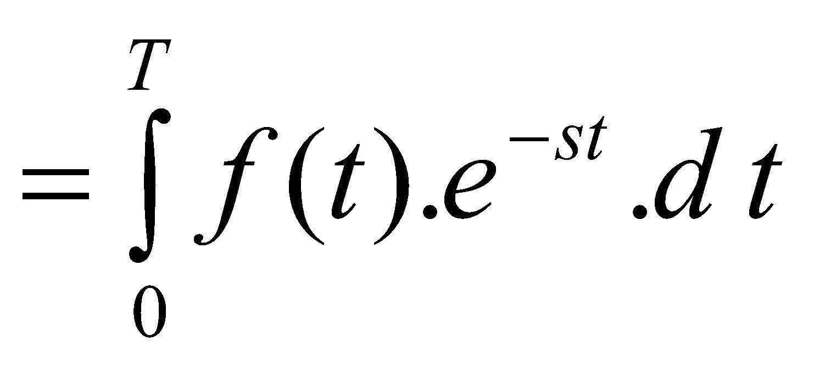
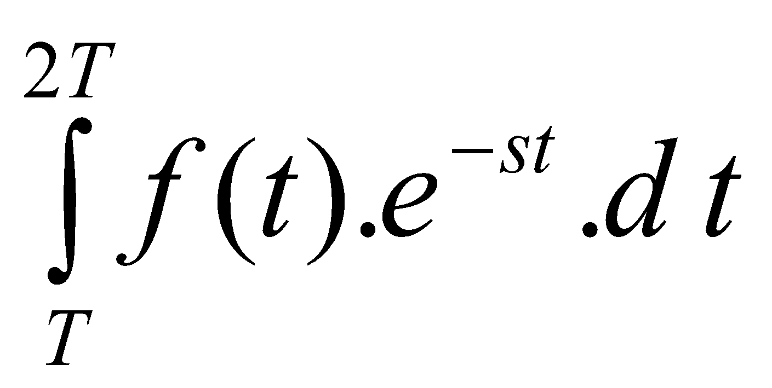
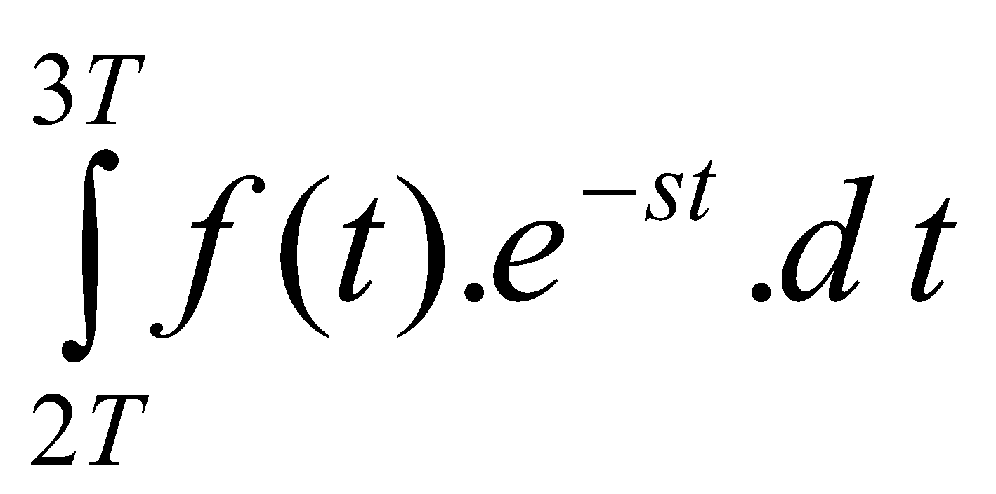
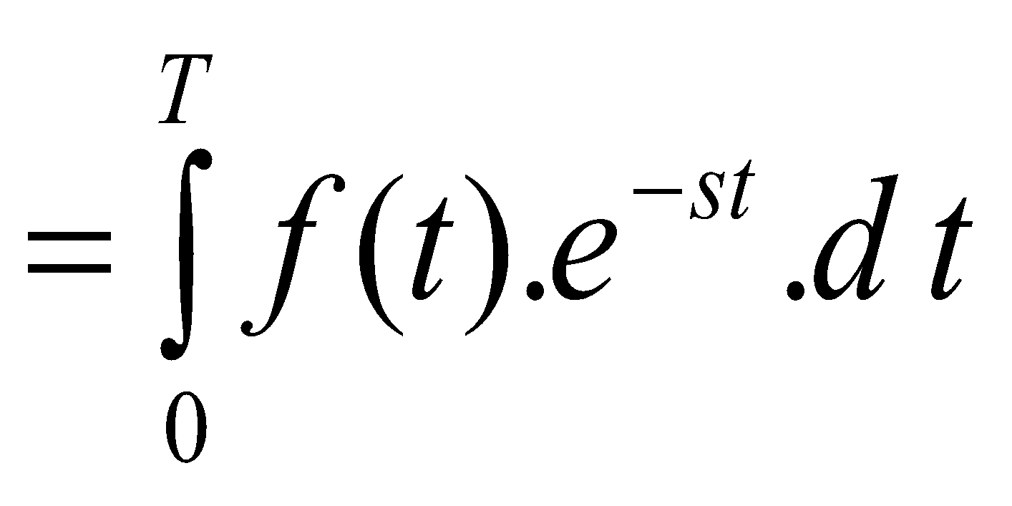
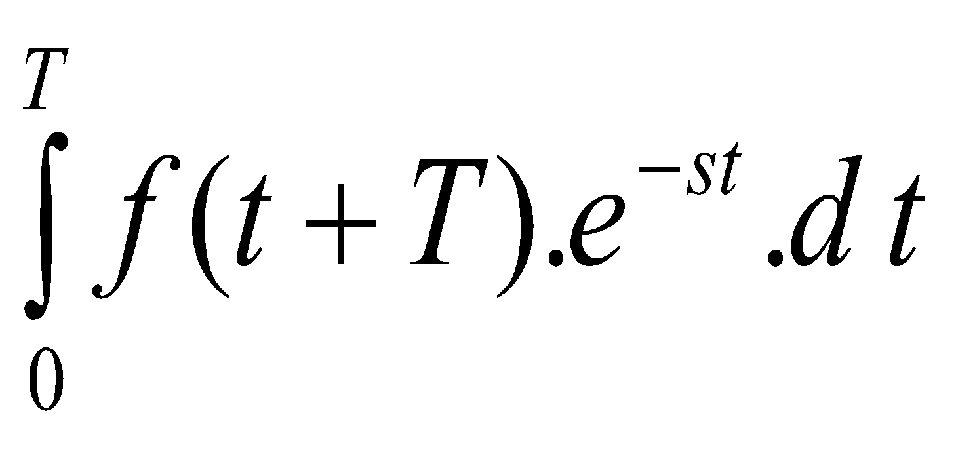
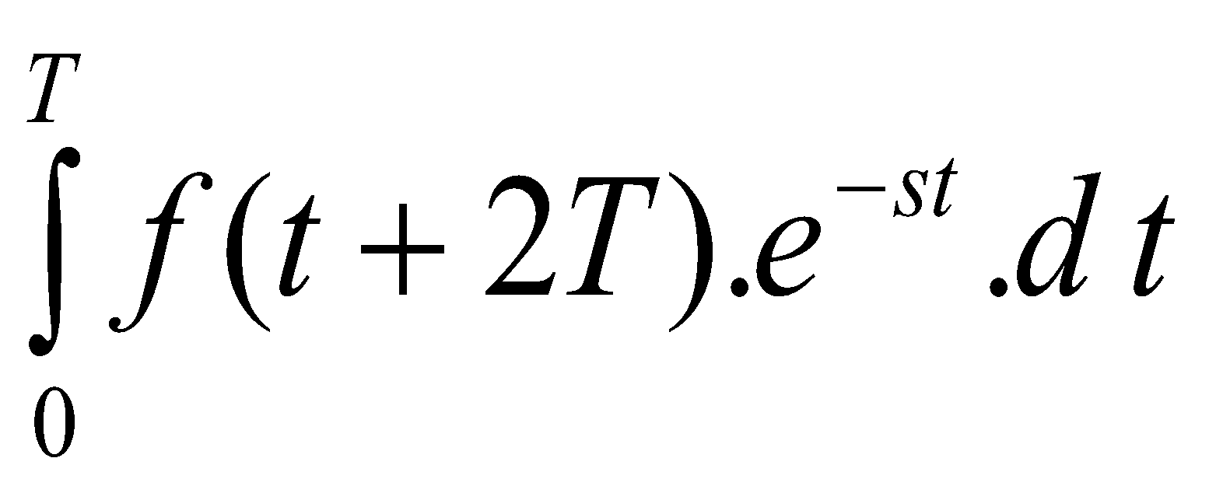
(h) For a periodic waveform f(t) with period T
L [f(t)]
+
+
+……
using a change of variables, may be re-written as
L [f(t)]
+
+
+……
Since the function is periodic,
f(t) = f(t+T) = f(t+2T) = …..

Slide 22
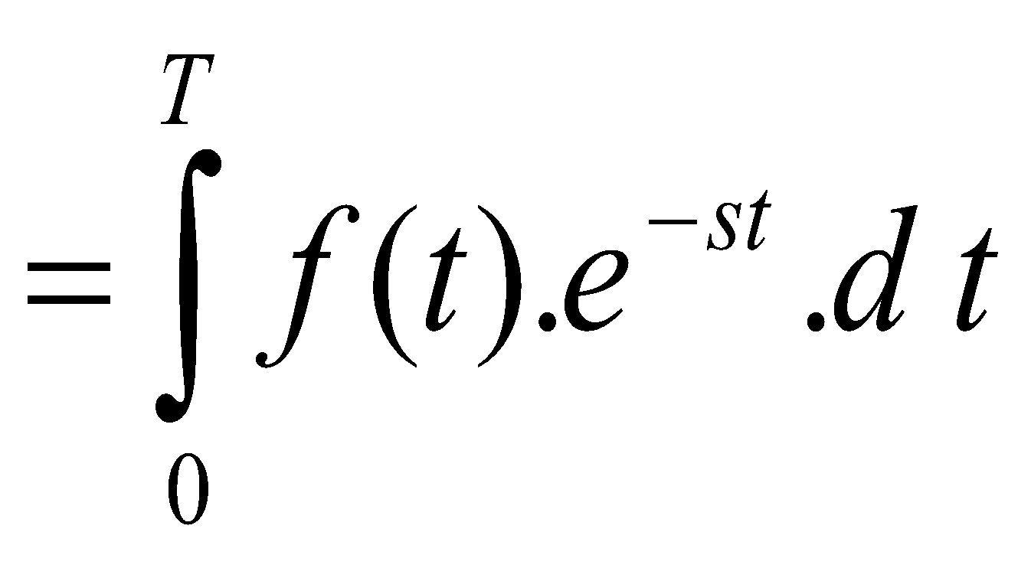
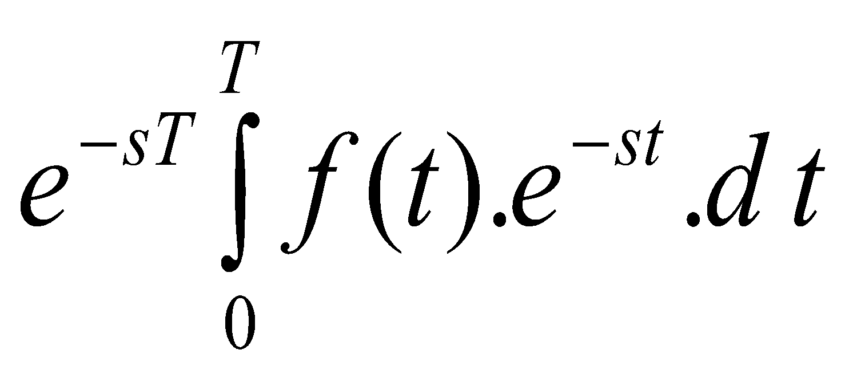
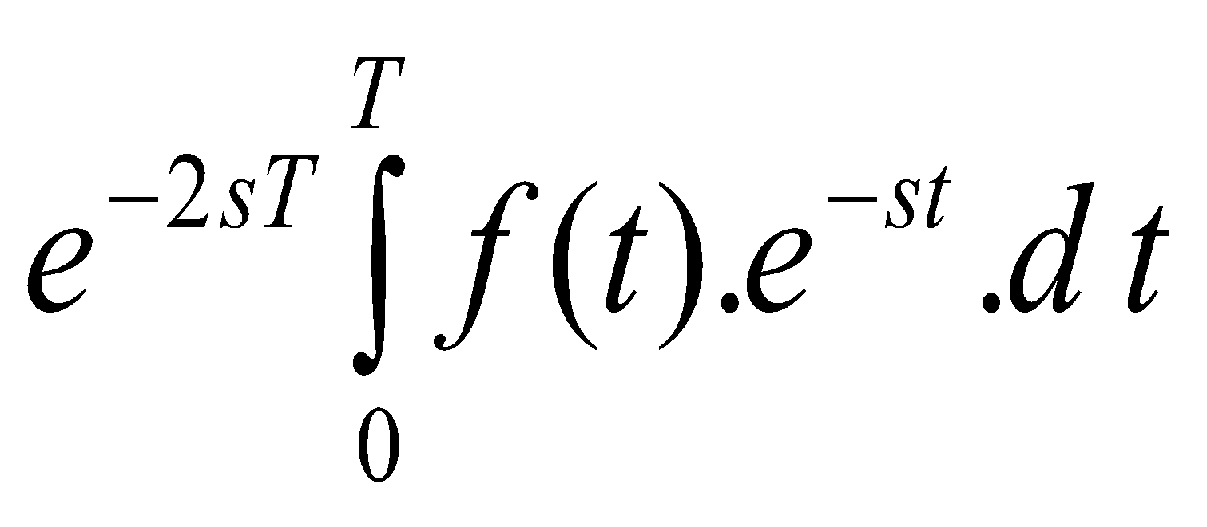
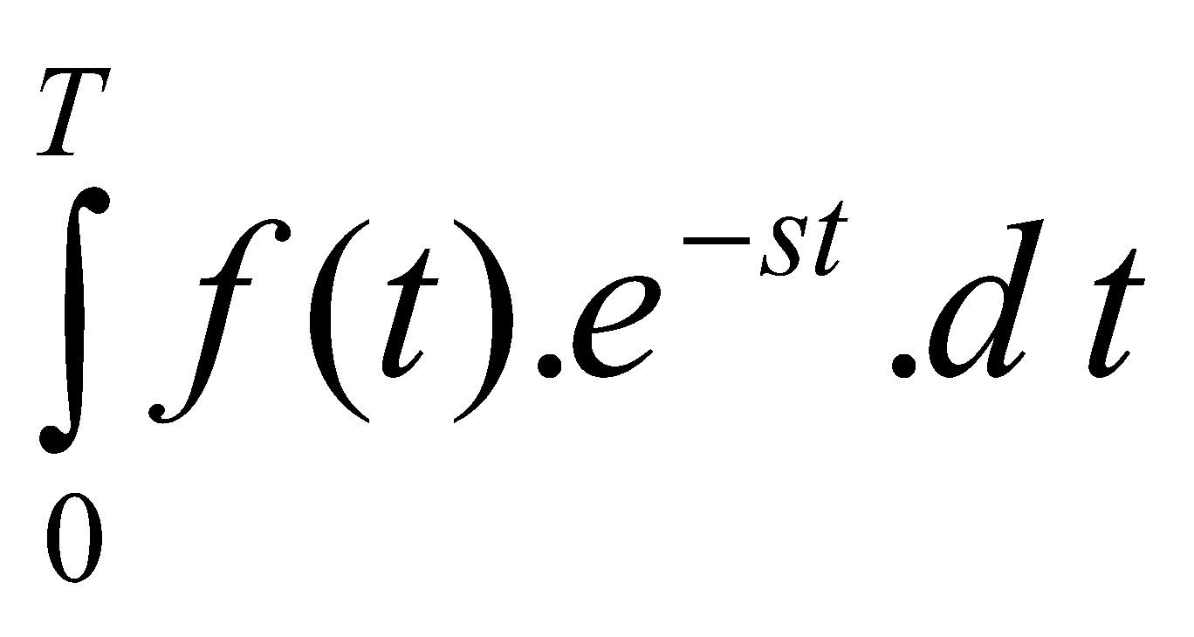
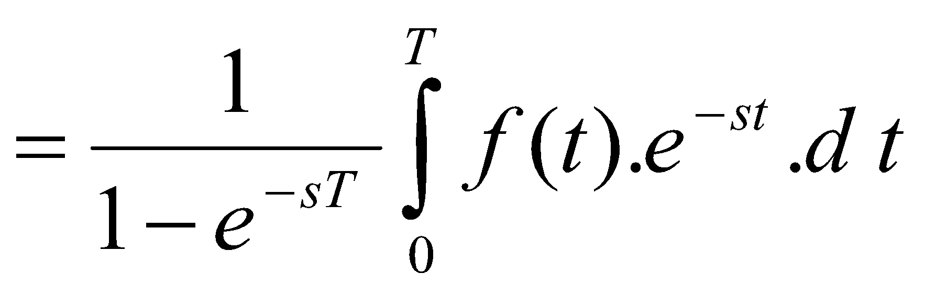
L [f(t)]
+
+
+……
= [1+ e^{-sT} + e^{-2sT} + e^{-3sT} + ……].
L [f(t)]
The transforms of other causal functions may be similarly obtained.

Slide 23
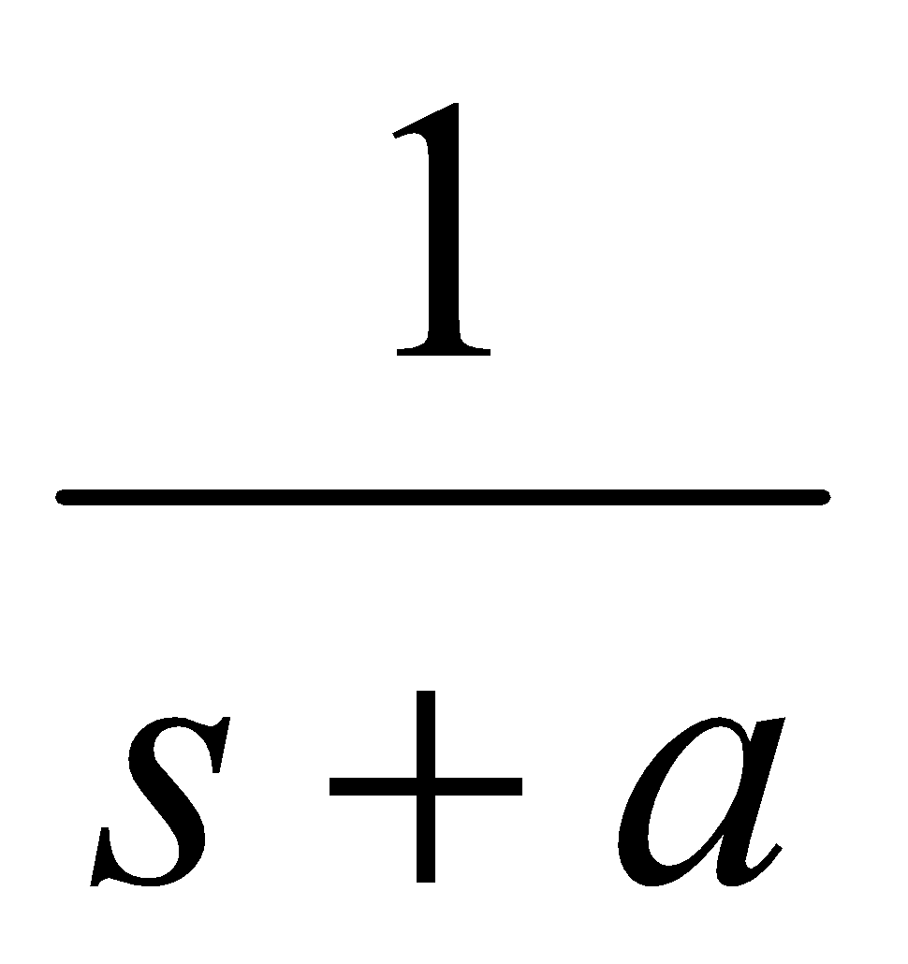
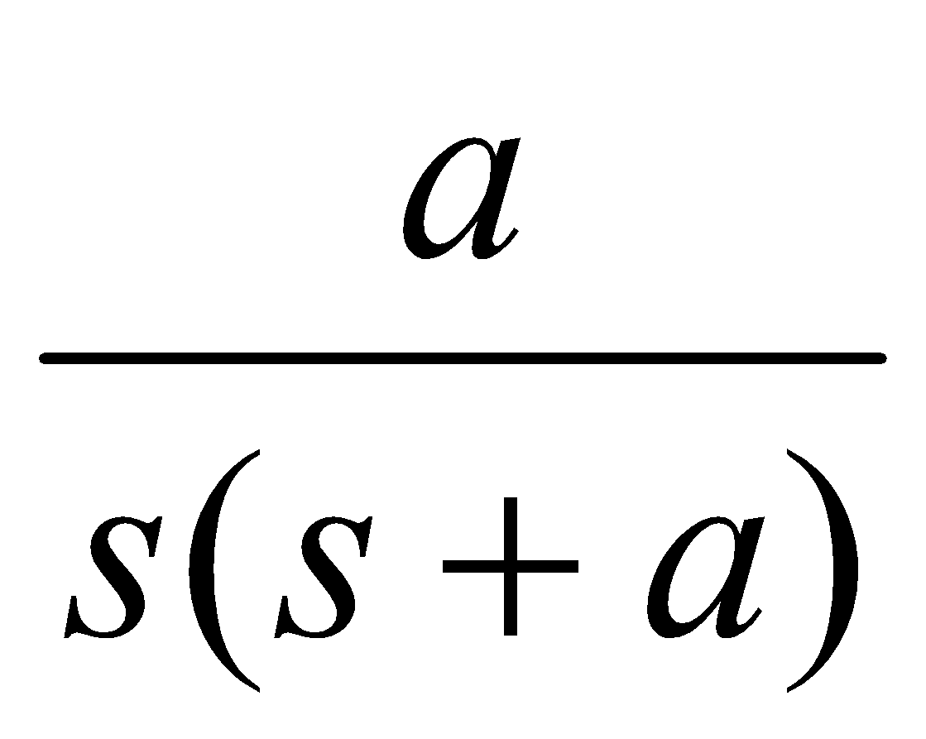




Laplace transforms for common causal functions
1
e^{-at}
0
t
unit impulse δ(t)
0
exponential decay
t
1- e^{-at}
0
exponential rise
t
0
unit step H(t)
e^{-a}-e^{-bt}
t
0
t
double exponential
0
t
unit ramp t
0
t
t .e^{-at}

Slide 24





Laplace Transform of Sinusoids
0
t
0
T
sin ω t
sine wave
t
rectangular pulse
t ^{n}
0
t
cos ω t
0
t
cosine wave
n^{th} order ramp (n > 0)
0
t
sin (ω t +φ)

Slide 25







Other Laplace Trasforms
sinh at hyperbolic sine
cosh at hyperbolic cosine
a.f₁(t)+ b.f₂(t) addition a.F₁(s)+ b.F₂(s)
first derivative s F(s) – f(0-)
n^{th} derivative
definite integral

Slide 26



t . f(t)
(-t)^{n}.f(t)
e^{-α t}.f(t)
exponential multiplier
F(s+α)
f(t – τ) shift in time e^{-sτ}.F(s)
periodic function
(period T)

Slide 27


Transient Analysis of Circuits using Laplace Transform
Electrical Circuits are usually governed by linear differential equations.
Since derivatives and integrals get converted to multiplications and divisions in the s-domain, solution of circuit equations can be converted to solution of algebraic equations.
Let us consider representation of the three basic circuit components, R, L and C, in Laplace Transform analysis.
i₁
i₂
R₁
L
C
e(t)
R₂

Slide 28


(a) Resistive Element R
R
R
¹/_{R}
i(t)
I(s)
I(s)
v(t)
V(s)
V(s)
v(t) = R . i(t) V(s) = R . I(s)
Thus the resistor may be represented by an impedance of value R even in the s-domain.

Slide 29





(b) Inductive Element L
V(s)
L
L s
L .i(0⁻)
i(t)
I(s)
I(s)
− +
v(t)
V(s)
v(t) = L .
V(s)= Ls. I(s) – L.i(0 ⁻)
Thus inductor may be represented by an impedance of value Ls and either a series voltage source or a parallel current source.
These sources represent the initial energy stored in the inductor at time t = 0. Thus the initial current i(0⁻) appears.

Slide 30






(c) Capacitive Element C
V(s)
C
I(s)
i(t)
I(s)
+ −
C s
v(t)
V(s)
C.v(0⁻)
i(t) = C .
I(s) = Cs.V(s) – C.v(0 ⁻)
Capacitor may be represented by an impedance of value and either a series voltage source or a parallel current source.

Slide 31
Transient Analysis
Using these circuits, and the transforms of source voltages and/or currents, the system transients could be obtained.
You would by now have realised that this method is much less tedious than the solution of the differential equations to find the transient solutions and then substituting the initial and final conditions applicable.

Slide 32

Example 1
Find the Laplace transform of the following waveforms.
f(t)
2E
(a)
0
T
2T
t
E
f(t)
E
(b)
f(t) = E sin ωt for 0 < t < T/2
f(t) = 0 elsewhere
0
T/2
t

Slide 33






Solution
(a) using first principles
L [f(t)]
=

Slide 34
Alternate solution
Using splitting up into known forms (ramp, step, etc)
(this is not always possible)
Part of ramp from t = 0 to T can be considered as the addition of a positive ramp at t=0, a negative ramp at t = T and a negative step of magnitude 2E at time t = T.
f(t)
f(t)
2E
2E
≡
0
T
2T
t
0
T
2T
t
E
E

Slide 35


Remaining part of waveform can be considered to be made up of a negative step waveform of magnitude E at t = T, and a positive step also of magnitude E at t = 2T.
Superposition of these waveforms gives the resultant waveform.
These have Laplace transforms which will add up as follows.
L [f(t)]
Identical to result obtained from the normal method.

Slide 36


(b)
f(t)
f(t)
E
E
0
T/2
t
0
T/2
t
Consider working this problem by splitting waveform.
Can be considered as been built up of a causal sine wave starting at t = 0, and a negative of sine wave starting at T/2.
Thus the transform of the waveform is given by
L [f(t)] =
=

Slide 37



Example 2
R
Determine the transient voltage appearing across capacitor when switch is closed at time t = 0.
Capacitor C is initially uncharged.
Solution
Transformed circuit is shown. Capacitor has not been associated with a source as there is no initial charge (or voltage) on the capacitor.
Using potential divider action
v_{out}
C
A sin ωt
R
V_{out}(s)

Slide 38




, where α =
This can be split into partial fractions as follows.
Using the tables, the inverse transform is then given as

Slide 39
Example 3
V₀
I(s)
In the series LC circuit shown, initially the capacitor is charged to a voltage V_{o} and inductor does not carry any current.
C
V
E
L
At time t = 0, a step voltage of magnitude E is applied to the series combination.
Determine the (a) the Laplace Transform circuit and (b) the transient voltage across L.

Slide 40



Solution
C
I(s)
E.H
i(t)
+ −
V₀
v(t)
V(s)
L
L s
Circuit is first transformed to Laplace domain.
Voltage-source form is selected for the capacitance as the circuit is a series circuit,
That form makes calculations easier.
Since there is no initial current in the inductor, no source is associated with the inductor.

Slide 41






I(s)
V(s)
L s
Let
,

Slide 42
Example 4
Figure shows a circuit which has reached steady state with switch closed.
If the switch S is opened at time t=0, obtain an expression for the ensuing current through the inductor.
S
R₁ = 10 Ω
C = 10 μF
L = 10 mH
E = 100 V
R₂ = 10 Ω

Slide 43



Solution
From potential divider action, under steady state conditions, half the supply voltage will drop across R₁ and half the voltage across R₂.
∴ voltage across capacitor initially is 100/2 = 50 V, and inductor current is 100/20 = 5 A.
Transform the circuit to Laplace domain.
I(s)
S
+
10
0.01s
−
−
0.01×5
+
10

Slide 44




Note the directions of the two new sources.
These correspond to directions of initial voltage across capacitor and initial current through inductor.
Note also that since switch S is now opened at t = 0, only other two branches will become part of circuit.
I(s)
S
+
10
0.01s
−
−
0.05
10
+
Thus I(s)
I(s)
Find inverse transform from the standard expressions,
i(t) =
A

Slide 45
End of Presentation

